Slide 1
EBAY WEBSITE
Under Guidance of Mrs. Vaishali Sonawane Mam.
-PRESENTATION BY: NINAD PRAMOD NASIKKAR

Slide 2
Introduction :
eBay is a leading online marketplace that connects millions of buyers and sellers WORLDWIDE.
EBAY IS a comprehensive platform offering a wide range of products, including electronics, fashion, SPORTS, COLLECTIBLES AND MORE

Slide 3
Overview
The main objective is To test the functionalities of ebay website using manual and automation testing.
TO CREATE PROJECT REQUIREMENTS.
TO EXECUTE MODULE WISE TEST CASES
TO IDENTIFY DEFECTS AND PREPARE DEFECT REPORT.
TO PREPARE TEST ANALYSIS REPORT.

Slide 4
Modules
Module 1 : Sign in page
Checked all the functionalities on Sign in page which included personal info as email address, password.
Module 2 : SEARCH
Checked all the functionalities TO SEARCH FOR A PRODUCT USING THE SEARH BOX.
Module 3 : ADD TO CART
Checked all the functionalities TO ADD A PRODUCT TO CART USING THE ADD TO CART BUTTON
Notes:
Module 1: Signn in page
Checked all the functionalities on Sign in page which included personal info as email
address, password
Module 2: Women page
Checked all the functionalities on Women page which included item details, Quantity, Filters,compare button,Add to cart button,product info,grid,list button
Module 3: Tshirt page
Checked all the functionalities on T-Shirt page which included item details, Quantity, Filters,compare button,Add to cart button,product info,grid,list button
Module 4: All Buttons and Drop Down Arrow :
team checked if all the buttons and drop down arrows of different fields are functioning properly or not

Slide 5
Module 4 : DELETE FROM CART
CHECKED IF A PRODUCT ADDED IN THE CART CAN BE REMOVED FROM THE CART OR NOT
Module 5 : LOGIN NAME
CHECKED IF THE USER IS ABLE TO CHANGE THE LOGIN NAME OR NOT.
Module 6 : ADDRESS
CHECKED IF THE USER IS ABLE TO UPDATE THE CURRENT ADDRESS OR NOT.
Module 7 : SHOP BY CATEGORIES
CHECKED THE FUNCTIONALITY OF SHOPPING BY CATEGORIES

Slide 6
Module 8 : SHOP BY ALL CATEGORIES
CHECKED THE FUNCTIONALITY OF SHOPPING BY ALL CATEGORIES
Module 9 : LANGUAGE
CHECKED THE FUNCTIONALITY TO CHANGE THE LANGUAGE OF THE ENTIRE WEBSITE.
Module 10 : SIGN OUT
CHECKED IF THE USER IS ABLE TO SIGN OUT OF THE WEBSITE.

Slide 7
Defects
While running a testcase at certain point some fields are not working as it is expected which is nothing but a defect, so I have created a Defect report on those defects.

Slide 8
Defect identifier :- B_001
Defect summary :-
THE PRODUCTS ON THE MOTORS > PARTS & ACCESSORIES > CAR & TRUCK PARTS & ACCESSORIES > STEERING AND SUSPENSION WHEN THE SORT BY: PRICE + SHIPPING : LOWEST FIRST FILTER IS APPLIED are not sorted properly.
Test Id :- TC_001
Test case name :- TC_FILTERS
Module name :- SHOP BY CATEGORY
Reproducible :-
Severity :- MEDIUm
Priority :- high
Raised by :- Team lead
Assigned to :- developer Team lead
Date of assignment :- 19/08/25
Status :- pending
Snap shots :-
Fixed by :- developer
Date of fixing :-

Slide 9
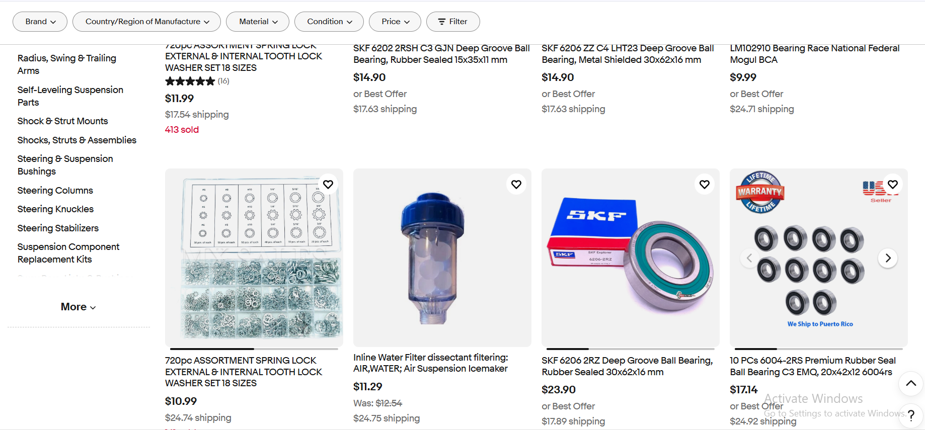

Slide 10
Defect identifier :- B_002
Defect summary :- the home page does not contain links to all the social media handles OF EBAY.
Test Id :- TC_002
Test case name :- TC_SOCIAL_MEDIA
Module name :- FOOTER
Reproducible :-
Severity :- LOW
Priority :- LOW
Raised by :- Team lead
Assigned to :- developer Team lead
Date of assignment :- 19/08/25
Status :- pending
Snap shots :-
Fixed by :- developer
Date of fixing :-

Slide 11
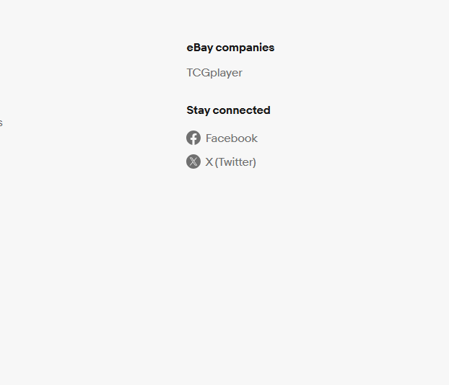

Slide 12
Challenges
While testing big website which contains huge data we faced some challenges about:
Handling huge and dynamic data(OTP VERIFICATION, PUZZLE) makes test execution slow and sometimes inconsistent.
Difference arises between expected results in written test cases and actual outcomes during execution.
SOMETIMES, EVEN AFTER USING THE CORRECT LOCATORS THE ACTUAL OUTCOMES ARE NOT AS EXPECTED.

Slide 13
Experience
Gained practical experience in identifying and reporting bugs through both manual and automation testing.
Learned the importance of strong observation skills while performing manual testing.
Improved understanding of synchronization issues, dynamic elements, and handling real-time challenges in large websites.

Slide 14
Thank You!!!
Vaishali Mam For Guiding Us through out the Project.

